Slide 1

Vrinda Store
The Main objective of
this project is to analyze
Sales data to gain
actionable insights that
Will enhance the
performance of the
Vrinda Store.

Slide 2
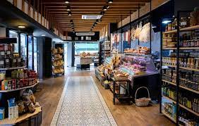
Recommended Analysis
1. How do the sales and orders of store compare using a single chart? 2. Who purchased more Men or Women in the year? 3. What were the different orders statuses in the year? 4. Which are the top 5 states contributing to the sales? 5. Show the relationship between age and gender based on several orders? 6. Which channel had the highest sales contribution?

Slide 3

Key Insights :-
The top 3 states contributing to sales are Maharashtra, Karnataka and Uttar pradesh.
Women made more purchases compared to men.
The adult age group(30-49 years) contributed the most to sales.
The channels with the highest sales contribution were Amazon, Flipkart and Myntra.

Slide 4

Conclusion of the Analysis :-
1). Focus on women customer in the adult age group from Maharashtra, Karnataka and Uttar pradesh for marketing. 2). Implementing distinct sales, advertisements and coupons during the month of March could prove beneficial in boosting sales and enhancing customer engagement. 3). Improve order status for better customer satisfaction and efficiency.

Slide 5
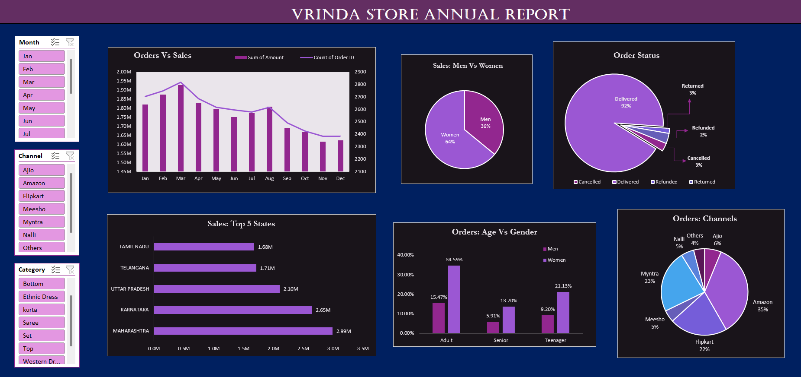
Dashboard

Slide 6
THANK YOU

